Slide 1

1
SHOOT ME IF
YOU CAN

Slide 2
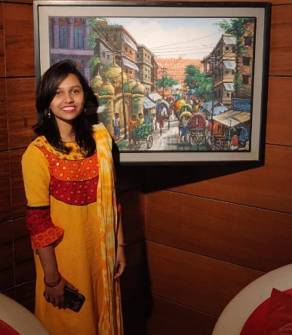
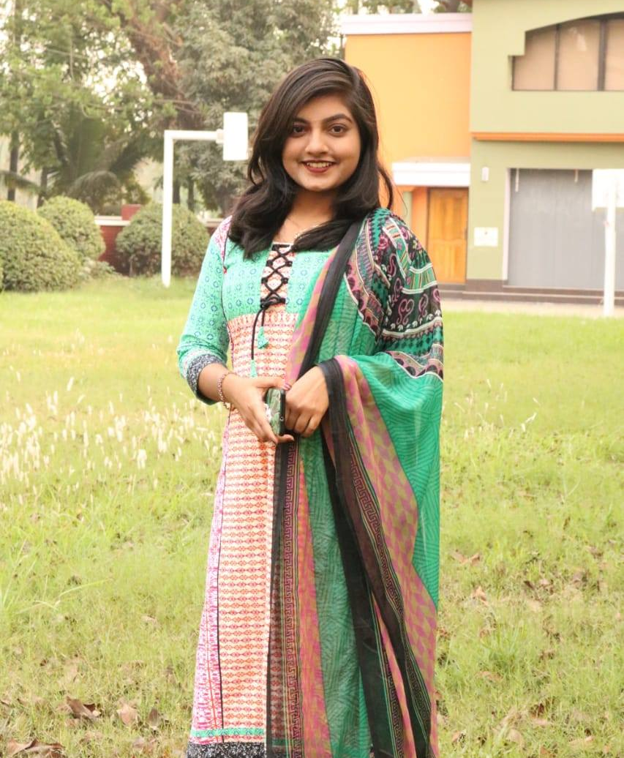

2
TEAM MEMBERS
NOVERA TASNUBA
RAISA FARIHA
FABIHA IFFAT
160041041
160041049
160041072

Slide 3
3
ABOUT
SHOOTING GAME
01
SUITABLE FOR A FIXED AGE
02
.
CAN PLAY ANYTIME,ANYWHERE
03
WHY PLAY? BECAUSE IT’S FUN!!
04

Slide 4
THINGS WE WILL USE :
4
PHYSICS
AUDIO
INPUT
UNITY ASSETS

Slide 5
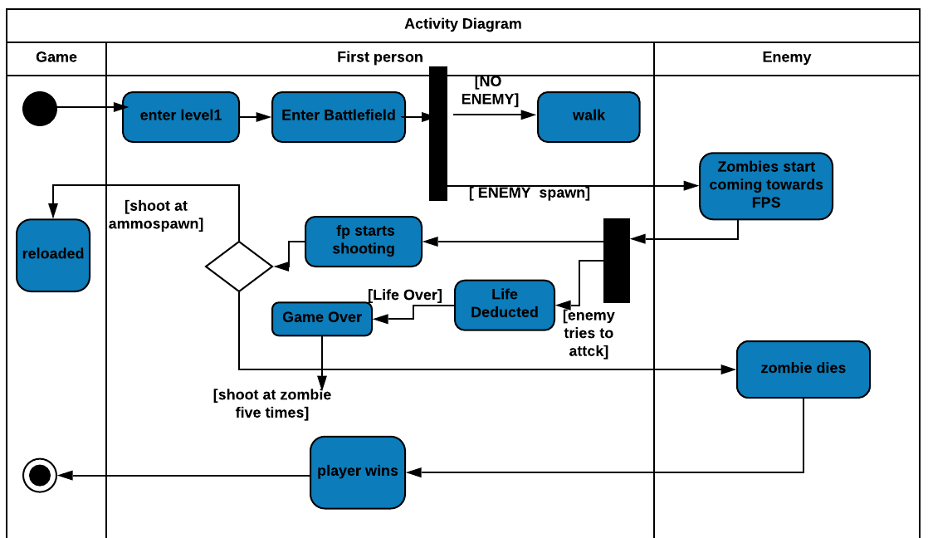
ACTIVITY DIAGRAM:
5

Slide 6
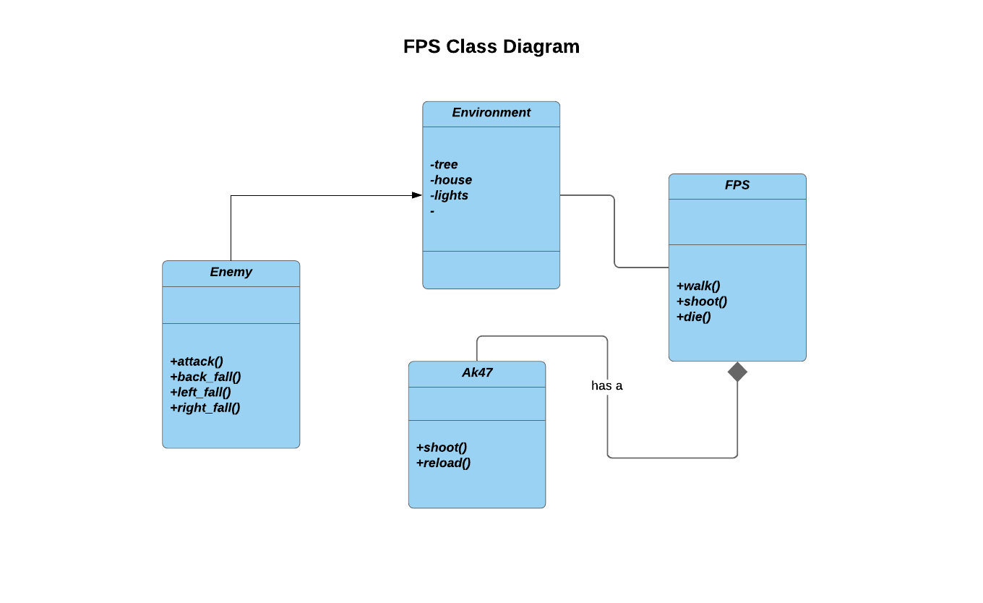
CLASS DIAGRAM:
6

Slide 7
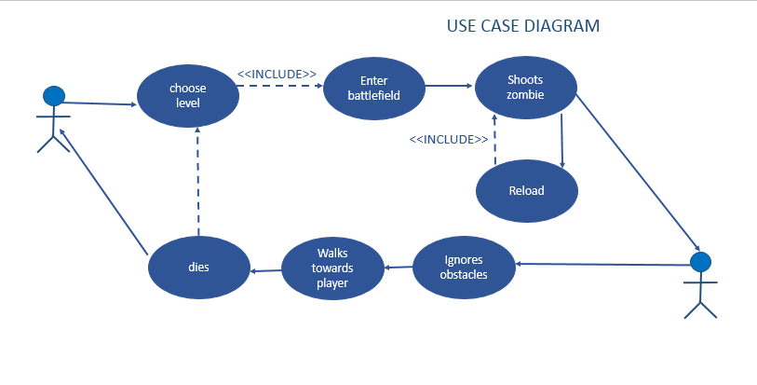
USE CASE DIAGRAM:
7

Slide 8
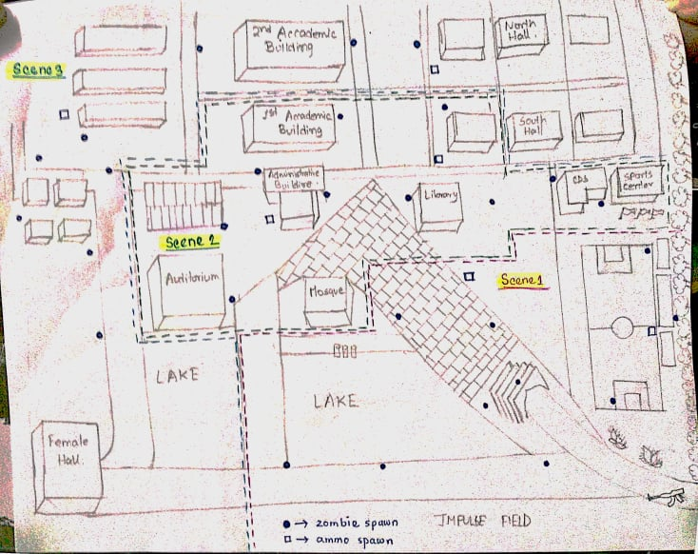
OUR PROPOSED SETUP:
8

Slide 9
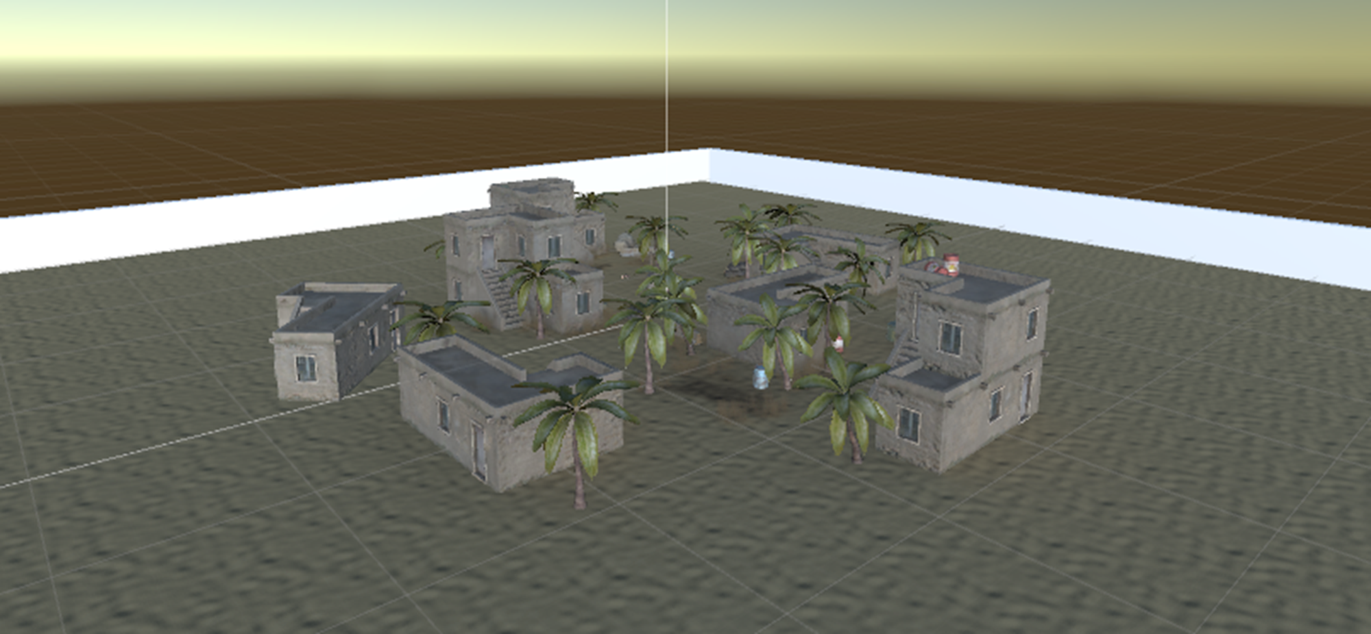
Initially IMPLEMENTED SETUP:
9

Slide 10
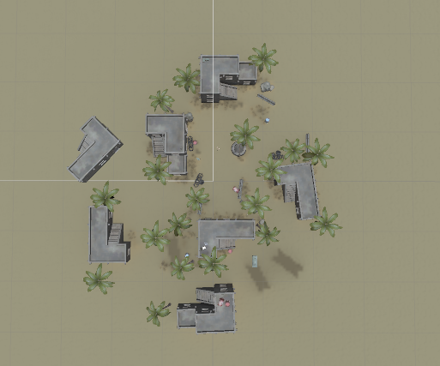
10
ENVIRONMENT SETUP:

Slide 11
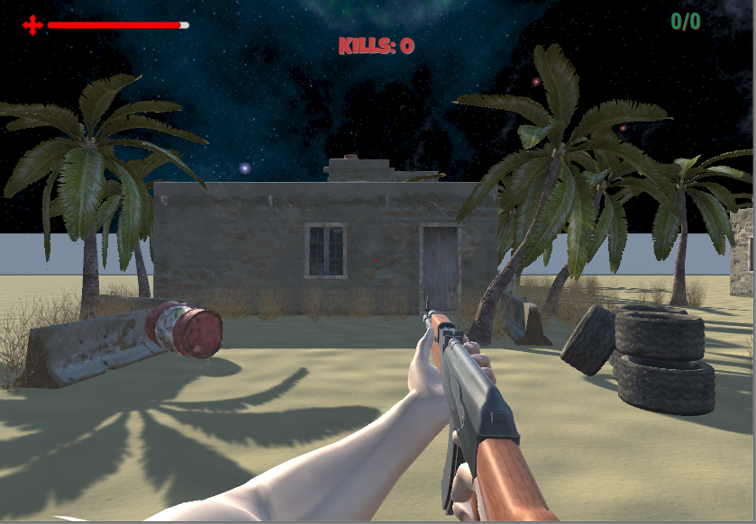
11
START SCENE:

Slide 12

12

